Slide 1
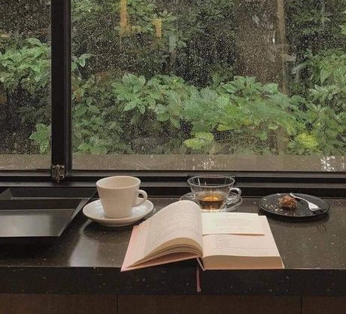
LESSON 1 Teacher: Danny

Slide 2
TABLE OF CONTENTS
01
02
03
5 RULES IN PRONUNCIATION
PRACTICE
TOPIC

Slide 3
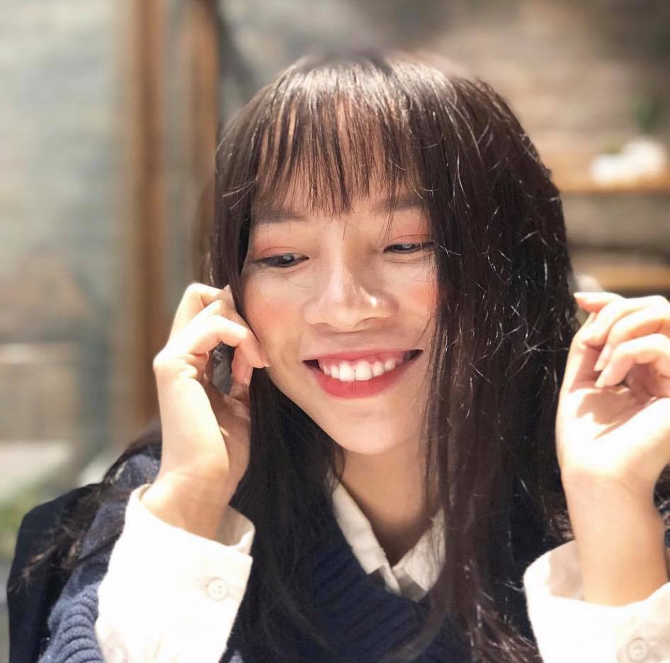
ABOUT THE TEACHER
28
25
27
DANNY
26
Name
29
30

Slide 4

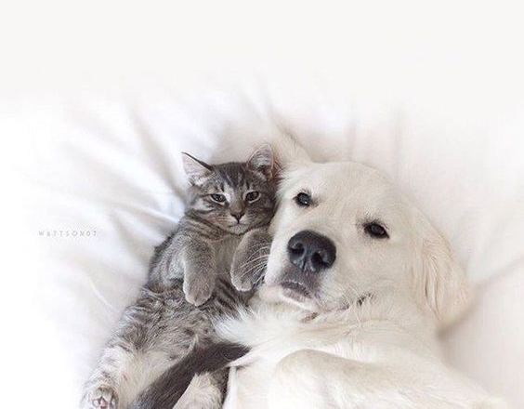
TEA COFFEE
CAT DOG
04
06
08

Slide 5
01
03
02
Hanoi University – English Department
Freelance Interpreter
& Translator
English Teacher

Slide 6

To the students
- Smile ☺
- I like questions => Ask me
- Try to speak as much as possible
- Get out of the comfort zone
- If you want to have something you never get, do something you never do before!!!
- Believe in yourself

Slide 7
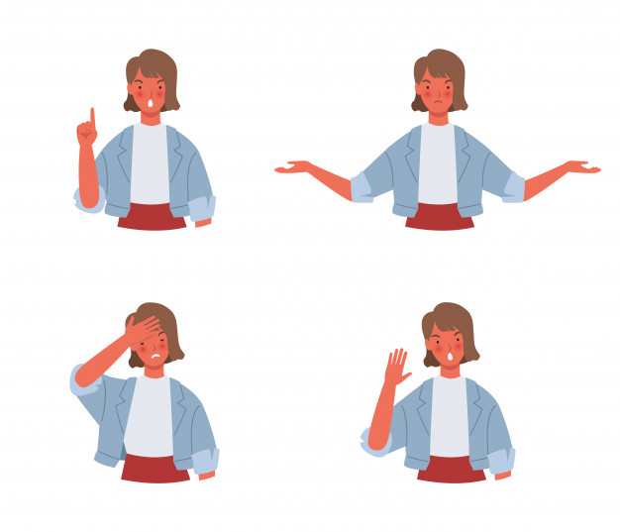
5 RULES IN PRONUNCIATION 1. Stress (start low, go down) 2. Endings 3. Separation 4. Say unvoiced sounds stronger 5. Use the lower throat

Slide 8
Explain: Vietnamese has short vowel sounds while English vowel sounds are longer Two things to remember: 1. Vowel sounds start low in the throat 2. They go down from there. All vowel sounds comes from the throat and goes down
#1 – Stress (1. Start low 2. Go down)

Slide 9
#2 - Endings
Explain:
Vietnamese does not have strong endings. Example: meo(cat) and banh (cake)
English does. Example: caT and caKe
This is why Vietnamese students often leave off endings, which is critical in English. “Tonight is a nice night” becomes “tonai ii a nai nai” if all the ends were taken off.
Two types of endings: voice and unvoiced

Slide 10
#3 – Separations
Students often combine/eliminate sounds. Separating sounds allows students to focus on individual sounds so they can say it more accurately.
1. Simple separation
Ca t (cat)
Ti(ee) m (time)
2. Complex separation
S wee t (sweet)
S to p (stop)

Slide 11
#4 Say unvoiced sounds stronger
- Vietnamese students often ignore unvoiced sounds.
- Demonstrate bad pronunciation: sittuh (sister), ip (if), thop (stop)

Slide 12
#5 Use your lower throat
- Vietnamese uses the upper part of the throat so Vietnamese students are familiar with this. They use that part of their throat to speak English so it all sounds very choppy. Vice versa, foreigners use their lower part of their throat to speak Vietnamese and it sounds strange to someone who speaks Vietnamese.
- This is also a part of rule number one, but it is so important, that it gets its own rule.
- The “ee” in baby goes down. Same as money, honey, and funny
- “My” also goes down and is not a raising “Mai”

Slide 13
PRACTICE!!!
1. I want to speak perfect English
2. A lot of people ask me how to sound like native speakers.
3. My cat is so cute and smart.
4. Do you like to study abroad?

Slide 14
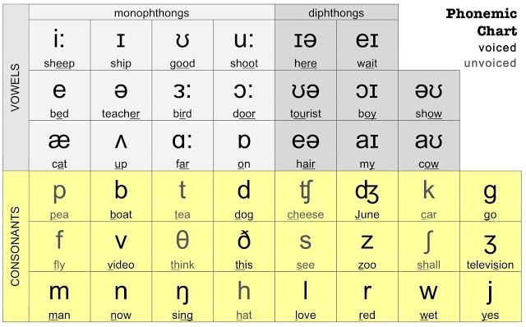

Slide 15
PRACTICE!
WORD STRESS
1. A. mountain | B. maintain | C. fountain | D. certain
2.A. reply | B. appeal | C. offer | D. support
3. A. answer | B. allow | C. agree | D. deny
4. A compare | B. approve | C. enter | D. pollute
5. A. mother | B. relax | C. father | D. garden

